Slide 1
Uncertainty Aware AI Systems
Week 6 51.516 Trustworthy AI Prepared by Group 1: Charles Foo, Lee Kai Boo, Sagar Pratap Singh, Sai Chin Kai (Clarence), Tan Ai Kun

Slide 2
Agenda
Lab scenario, dataset, and the class-imbalance problem
Step 1: Train a baseline model and measure clean accuracy
Step 2: Measure confidence and observe its saturation
Step 3: Identify silent failures (high-confidence errors)
Step 4: Observe Out-of-Distribution (OOD) behaviour
Step 5: Examine the error profile and accuracy trap (confusion matrix)
Step 6: Design Human-in-the-Loop routing and select a confidence threshold
Reflection on the audit findings
2

Slide 3
Lab Scenario & Objective
Role: an independent auditor reviewing an automated credit-card fraud detection system
The model predicts whether a transaction is fraudulent (positive) or legitimate, used to auto-approve or block transactions
The audit's focus: not just is the model accurate, but does it know when it should not decide
Objective of the audit:
Train a baseline fraud model and record its clean accuracy
Measure prediction confidence and test whether confidence reflects correctness
Detect silent failures and Out-of-Distribution weaknesses
Design a Human-in-the-Loop escalation policy and evaluate its trade-offs
3

Slide 4
Dataset: Kaggle Credit Card Fraud
Kaggle Credit Card Fraud dataset: 284,807 real transactions, 30 features
Target: fraud (positive / Class = 1) vs legitimate (Class = 0)
Severe class imbalance: only 492 frauds = 0.1727% of all transactions
Features: Time, Amount, and V1–V28 (anonymised PCA components from the original transaction data)
Stratified 80/20 train-test split preserves the fraud ratio (train 0.1729%, test 0.1720%)
4

Slide 5
Method & Preprocessing
We set up a Logistic Regression classifier (scikit-learn, max_iter=1000) trained to predict fraud vs legitimate
Numeric features Time and Amount were standardised using StandardScaler; V1–V28 were left unchanged as they are already PCA-transformed and scaled
The scaler was fitted on the training set only, then applied to the test set and deliberately retained in memory so the same transform could be applied to the Out-of-Distribution samples later (Step 4)
We made a design choice to keep the baseline deliberately plain, ie. no class-weighting or resampling so that the model's natural overconfidence and silent-failure behaviour would be visible rather than masked by mitigation
Stratified 80/20 split: 227,845 training rows, 56,962 test rows
5

Slide 6
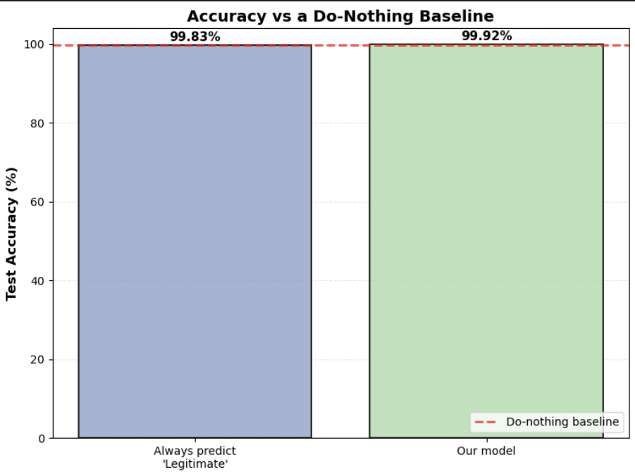
Step 1: Baseline Model & the Accuracy Trap
Baseline Logistic Regression reaches 99.92% clean accuracy on the 56,962-row test set
On its own, this looks near-perfect, but accuracy is misleading under severe class imbalance. A naïve model that simply predicts "legitimate" for every transaction would score 99.83% ( this is also what the dataset shows)
Our model beats that do-nothing baseline by just 0.088 percentage points, almost all of the 99.92% is the abundant legitimate class, not fraud detection
Accuracy alone cannot tell us whether the model can actually catch fraud (examined in Step 5)
6

Slide 7
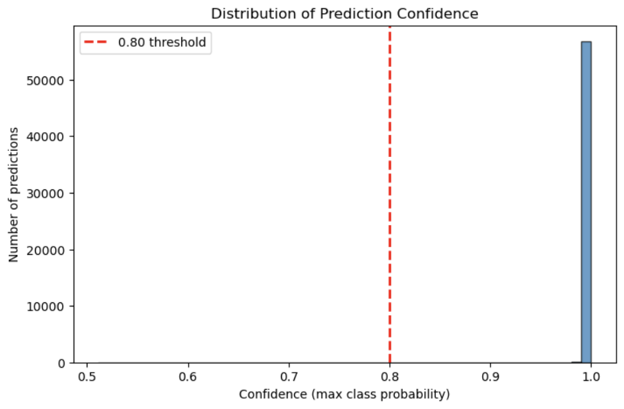
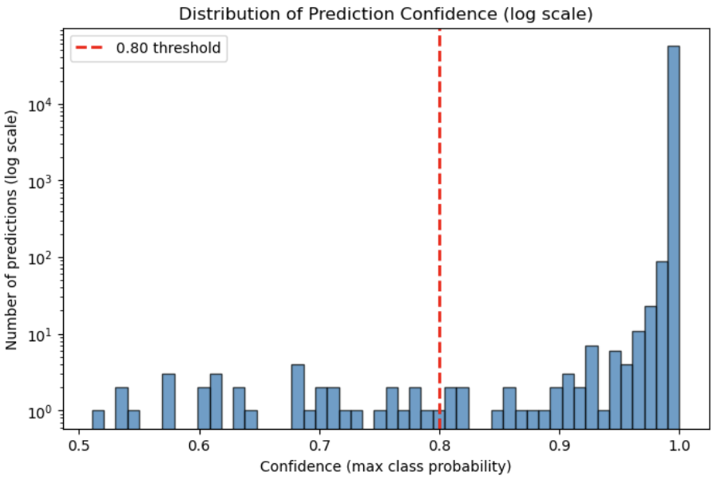
Step 2: Confidence Scores & Saturation
Confidence = the model's highest class probability: max(P(legitimate), P(fraud))
Across the 56,962 test predictions, confidence is extremely saturated: mean 0.9993, median 0.9998
99.92% of predictions exceed 0.90 confidence; 91% exceed 0.999, the model is almost never unsure
The linear histogram shows one dominant spike at ~1.0; the log-scale view reveals only a tiny tail of low-confidence cases (minimum 0.5109)
Implication: if the model is confident about nearly everything, confidence alone cannot separate safe predictions from dangerous ones
7

Slide 8
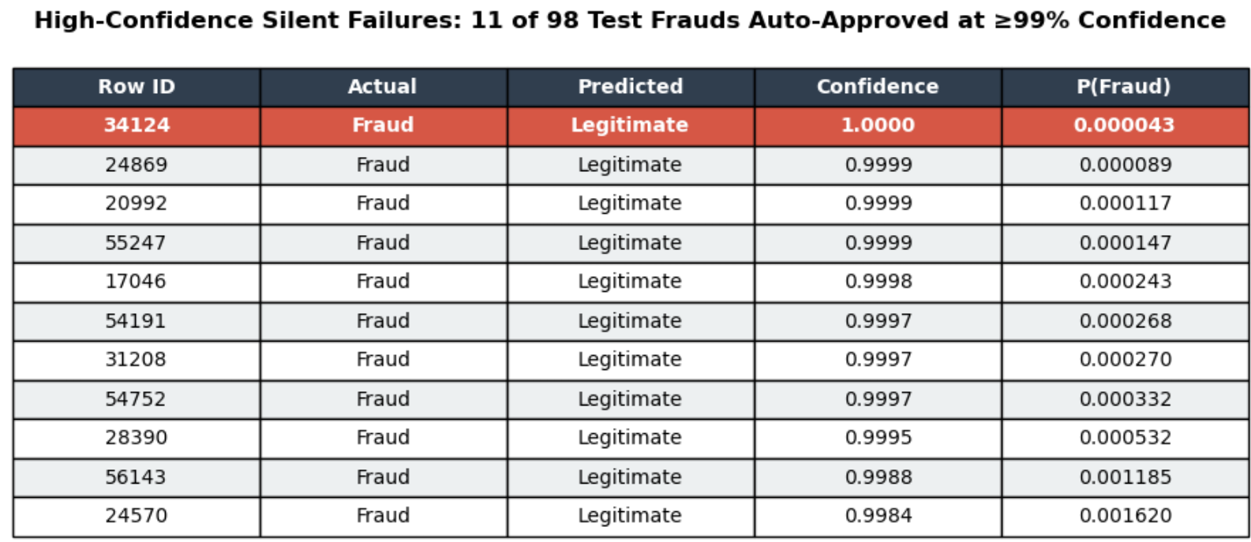
Step 3: Silent Failures (High-Confidence Errors)
A silent failure = a prediction that is wrong but made with high confidence, a most dangerous failure mode, because the model gives no signal that it is unsure
We isolated test cases where an actual fraud was predicted legitimate at ≥ 0.99 confidence
11 of the 98 test frauds (11.2%) were confidently misclassified as legitimate, and auto-approved with no hint of doubt
The worst case (row 34,124) was a genuine fraud the model rated 99.996% legitimate, and assigning it just a 0.0043% probability of fraud
These failures sit inside the dominant high-confidence spike from Step 2, so no confidence threshold can catch them, because the model is certain about them
8

Slide 9
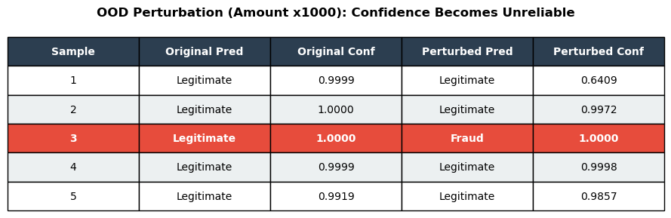
Step 4: Out-of-Distribution (OOD) Behaviour
We took 5 legitimate test transactions the model was confident about, then pushed them far outside the training distribution: Amount × 1000, re-scaled through the same fitted scaler
The confidence response was inconsistent and unreliable, not uniformly anything:
One transaction (S3) flipped to "fraud" at 100.00% confidence confidently wrong on an input never seen in training
Three (S2, S4, S5) stayed "legitimate" at 98.6–99.98% confidence despite being inflated 1000×
Only one (S1) showed appropriate doubt, confidence falling to 64%
Structurally, most transactions sit so deep in "legitimate" territory that even a 1000× amount increase cannot move them. Only cases (Sample 3) already near the decision boundary can flip. Confidence therefore cannot be trusted to rise under distribution shift, failing exactly when oversight is most needed.
9

Slide 10
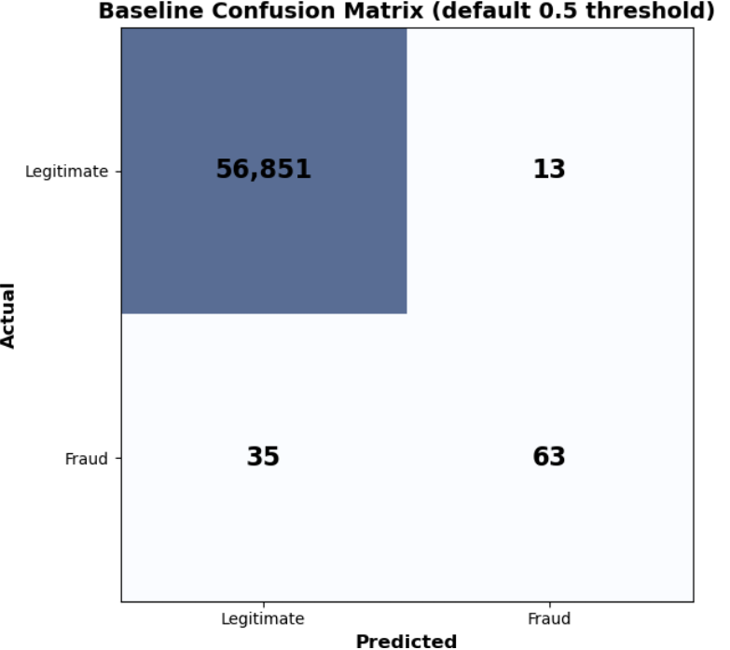
Step 5: Error profile and accuracy trap (confusion matrix)
The confusion matrix exposes what 99.92% accuracy concealed: at the default 0.5 threshold, fraud recall is only 0.64 (63 / (63+ 35))
Of 98 (63 +35) test frauds, the model caught 63 but missed 35 (false negatives), over a third of all fraud slipped through.
It also raised 13 false positives: legitimate transactions wrongly flagged, so errors occur in both directions
Reconciliation with Step 3: of the 35 missed frauds, 11 were the high-confidence silent failures (≥ 0.99 confidence) and cannot be caught by confidence-based escalation; the other 24 were missed at lower confidence and are potentially recoverable through human review
-ve
TN
FP
+ve
FN
TP
-ve
+ve
10

Slide 11
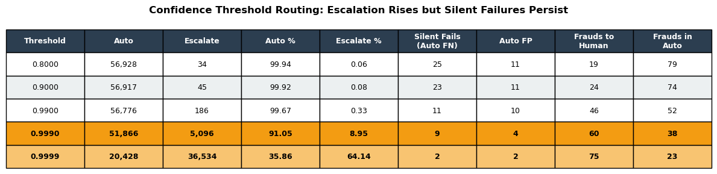
Step 6: Human-in-the-Loop Threshold Routing
We selected five thresholds: 0.80, 0.90, 0.99, 0.999, 0.9999. Deliberately spanning from a conventional cut-off up into the extreme high-confidence range, because Step 2 showed over 99% of predictions exceed 0.99; a conventional threshold alone would sit below almost all the data and escalate nothing
Because confidence is saturated (Step 2), thresholds of 0.80–0.90 escalate almost nothing, automation stays ~99.9% and silent failures pass straight through
The dial only engages in the extreme high range: at 0.999, escalation rises to 8.95% and 60 of 98 frauds reach a human; at 0.9999, escalation jumps to 64.14% but auto-approved silent failures only fall to 2
The core trade-off: cutting silent failures from 9 to 2 requires escalating ~64% of all transactions to humans. Whether this is worthwhile is a domain decision, weighing the cost of each missed fraud against the human-review burden (our view is it is worth it as stakes are high).
(Note: even at the tightest threshold, 2 silent failures remain, the highest-confidence frauds sit beyond any cut-off, so escalation cannot catch them all)
11

Slide 12
Key Takeaways & Conclusion
Accuracy concealed the real risk: 99.92% accuracy was barely above a do-nothing baseline (+0.088%), while the model missed 36% of fraud and produced 11 high-confidence silent failures
Confidence is not correctness, and not enough on its own: it was saturated near 1.0 (Step 2), unreliable under distribution shift (Step 4), and blind to high-confidence silent failures (Step 3). So it must be paired with monitoring, audit, and human oversight rather than trusted as a standalone signal
The threshold is a values decision, not a technical optimum: the right cut-off depends on weighing the cost of a missed fraud against the human-review burden, and on the consequences the domain can tolerate
For this high-stakes fraud setting, we weight safety over automation and favour a strict threshold (0.9999): it cuts auto-approved silent failures to 2, accepting that ~64% of transactions require human review
Core principle: a trustworthy system is designed to recognise its own uncertainty and escalate, it knows when not to decide
12

Slide 13
AI Usage
Claude Opus 4.8 was used to discuss on how to approach the Lab design and implementation
Prompt by prompt was generated by Claude Opus 4.8 as inputs to VS Code AI (Claude Sonnet 4.5) to generate the jupyter notebook
Claude Opus 4.8 is used to check the completed PPT with the notenook for errors.
13

Slide 14
Reflections
14

Slide 15
Reflection (Ai Kun)
One of the most telling findings from this lab was that the model’s most dangerous mistakes occurred when it was most confident. Under normal circumstances, confidence may serve as a useful indicator of reliability, but the audit showed that high confidence and correct predictions are not the same thing. Some fraudulent transactions were confidently classified as legitimate, while out-of-distribution samples also received extremely confident predictions. This demonstrated that confidence reflects only what the model believes, not whether it is actually correct.
The Human-in-the-Loop exercise reinforced this insight. Confidence thresholds were effective only for cases where the model was already uncertain, but they could not prevent high-confidence silent failures. Tightening the threshold reduced some risk, but only at the cost of dramatically increasing the number of transactions requiring manual review. This made me realise that designing Trustworthy AI is not about finding a perfect confidence threshold, but about balancing automation, safety, and operational cost according to the risks and consequences of the deployment context.
Across the six labs, a consistent theme has emerged: Trustworthy AI is not achieved through accuracy, explainability, fairness, or confidence alone. Each addresses a different aspect of trust, but none is sufficient on its own. Ultimately, trustworthiness comes from recognising the limitations of AI systems and designing governance mechanisms that determine when a model can make decisions autonomously and when it should defer to human judgement.

Slide 16
Reflection (Charles Foo)
We audited a fraud model reporting 99.92% accuracy and found almost none of it was real fraud detection, a model labelling every transaction "legitimate" would have scored 99.83%, so ours added just 0.088 points while missing 36% of all fraud. 11 missed frauds were waved through at over 99% confidence, 1 rated 99.996% legitimate.
Confidence offered no protection: saturated near 1.0 across nearly every prediction, it grew most certain on exactly the out-of-distribution cases the model had never seen. Neither accuracy nor confidence measured safety.
This exposes the structural limit of confidence-based human-in-the-loop design. A confidence threshold escalates the cases the model already doubts, but the most dangerous failures, which are the high-confidence silent failures , sit beyond any threshold, in the spike at 1.0. We confirmed this in the routing experiment: even at 0.9999, two frauds were still auto-approved with full confidence, and reaching that point required escalating 64% of all transactions. Tightening the dial cannot reach the failures that matter most.
If I were designing the governance for such a system, I would not rely on a single confidence gate. I would use a layered control plane: confidence-thresholding as the first filter for ordinary uncertainty; a separate out-of-distribution monitor that watches for inputs drifting from the training distribution regardless of how confident the model is; and a mandatory periodic audit that re-samples high-confidence fraud-negative decisions, since those are exactly the silent failures no live signal will flag. Crucially, the decision threshold (how readily the model calls fraud) and the escalation threshold (when a human reviews) would be governed as two independent levers, because conflating them is what lets confident errors through.
The lab reinforced my view that trustworthiness is an architectural property, not a metric. A model cannot be made safe by reading its confidence any more than by reading its accuracy; both can be high and wrong at once. Safety comes from designing the system to recognise the limits of its own certainty, and to escalate, monitor, and remain accountable to human oversight, so that it knows when not to decide, even when it feels sure.

Slide 17
Reflection (Sagar Pratap Singh)

Slide 18
Reflection (Kai Boo)
The most important lesson from the week 6 lab audit was how a seemingly perfect score can hide massive risks. Our fraud detection model achieved a 99.92% accuracy rate, which looks amazing at first glance. However, because fraud is so rare in the dataset (only 0.17%), a completely useless model that just labels every transaction "legitimate" would still be 99.83% accurate. Our model only beat that "do-nothing" baseline by a tiny 0.088%, meaning it actually missed over a third of all real fraud cases. This "accuracy trap" proves that high accuracy alone does not mean a system is safe or effective.
What makes this dangerous is that the model's worst mistakes happened when it was most confident. Its confidence scores were heavily saturated near 1.0, meaning it was functionally incapable of expressing doubt. This led to "silent failures," where real fraud was waved through as legitimate with zero warning signs—including one genuine fraud case that the model rated 99.996% legitimate. To make matters worse, when we tested out-of-distribution (OOD) data by inflating transaction amounts 1,000 times, the model didn't become less certain; it stubbornly maintained near-perfect confidence on data it had never seen before.
The routing experiment showed there is no easy fix using simple confidence thresholds. Because the model is so overconfident, setting a normal threshold does nothing. To catch the missed fraud, we have to raise the threshold to an extreme 0.9999, which floods human reviewers by sending over 64% of all everyday transactions to them. Ultimately, this lab shows that a trustworthy AI system cannot rely on a single confidence check. True safety requires a layered approach, blending separate out-of-distribution monitors and regular human audits so the system knows its own blind spots and recognizes when not to decide.

Slide 19
Reflection (Clarence)
At first, the 99.92% accuracy made the fraud model look good. But a model that simply predicts “legitimate” every time already scores 99.83%, which is almost the same. That showed me accuracy can be misleading when fraud is such a small part of the data, because the model was still missing many real fraud cases.
What stood out most was the silent failures. Several real fraud cases were approved as “legitimate”, and the model was extremely confident. One fraud case was rated 99.996% legitimate. That is not just a normal mistake. It is the model being confidently wrong with no warning sign.
The out-of-distribution test made this even clearer. We changed a transaction amount to something far outside the training data, expecting the model to become less sure. Instead, most predictions barely changed. The model did not recognise that the input was unusual. It just continued making predictions as if everything was normal.
The threshold experiment showed there is no easy fix. Raising the threshold caught more risky cases, but it also sent many more transactions to human review, and some silent failures still got through. The main lesson is that accuracy and confidence alone cannot prove the system is safe. We need layered checks, such as out-of-distribution monitoring, regular audits, and human oversight, because the model may not flag its own blind spots.

Slide 20
End.

